Slide 1
Real Estate
-Sreejeeth Ramprasad(1MV15IS050)
-Mohammed Sharique Nawaz(1MV15IS018)
-Sayantika Banik(1MV15IS067)

Slide 2
Problem Statement
At some point of time , we will all end up in a situation to hunt for a house for rent or for sale.
The house hunting can get really hard for it has to match our likings and should also be located in an area with good facilities and amenities . And most importantly, it should be within our budget .
Our project helps in reducing the efforts that is to be taken by people while hunting for houses.

Slide 3
What method we use
INDEXING
There are 3 kinds of indexing :-
1)Primary index
2) Clustering index
3)Secondary index

Slide 4
How we solve the problem
We list the names of houses that are available for rent or sale , in our portal .
We list the specifications of the houses so that the people can decide what kind of amenities they wish to settle for.
The specifications can be a combination of the following:
1)House Type
2)Square feet of the house
3)Number of Bedrooms
4)Amenities like gym , swimming pool , club house ,etc
5)Legal documents
6)etc…

Slide 5
Why indexing ?
Data is usually stored in random order in hard disk.In order to search for a data , we will require to do sequential searching which takes a lot of time .
So we can think of sorting the data in hard disk . But for sorting all the data , we need to put them all in the main memory . This is practically not possible as main memory will usually be way smaller than the amount of data in the hard disk . Therefore we use indexing .

Slide 6
Primary Indexing
A single level index is an auxiliary file that makes it more efficient to search for a record in the data file.
The index is usually specified on one field of the file ( it can also be more than one field ) .
One form of index can be a file of entries <field value, pointer to record > . This is ordered by field value .
The index file usually occupies considerably less disk blocks than the data file because its entries are much smaller.
A binary search on the index yields a pointer to the record.

Slide 7
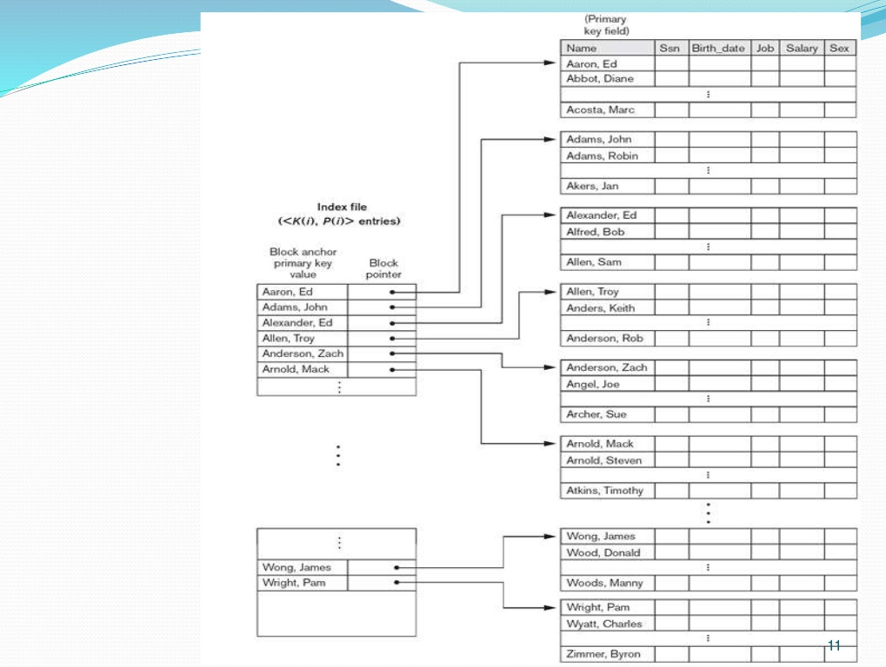

Slide 8
Conclusion
Therefore , by using the indexing , we reduce the time complexity from O(n) to log n .
The user can view various houses of his / her choice of specifications and narrow down their options to a great , condensed list .

